Slide 1
Data Synchronization
Lecturer: Ngo Huy Bien
Software Engineering Department
Faculty of Information Technology
VNUHCM - University of Science
Ho Chi Minh City, Vietnam
nhbien@fit.hcmus.edu.vn

Slide 2

References
Zach McCormick and Douglas C. Schmidt. Data Synchronization Patterns in Mobile Application Design. PLoP '12. Tucson. 2012.
Christoph Fehling et al. An Architectural Pattern Language of Cloud-based Applications. Conf. on Pattern Languages of Programs, Portland. 2011.
Idilio Drago et al. (2012). Inside Dropbox - Understanding Personal Cloud Storage Services.
Zhenhua Li et al. (2013). Efficient Batched Synchronization in Dropbox-Like Cloud Storage Services.

Slide 3
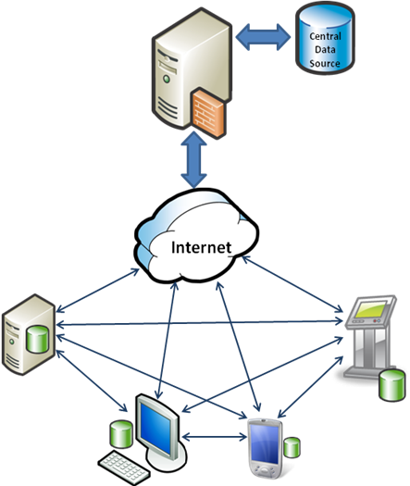
Data Synchronization Patterns [1]

Slide 4
Asynchronous Data Synchronization
Problem
A non-responsive or slow-to-respond application yields a poor user experience.
Even if an application responds to user input quickly, however, a user will be frustrated if they must wait for significant periods of time for data to load.
Solution
Initiate data transfer asynchronously via a trigger (such as a user action, a timer tick, an Android “intent”, or a push notification in iOS) and perform the transfer asynchronously.

Slide 5
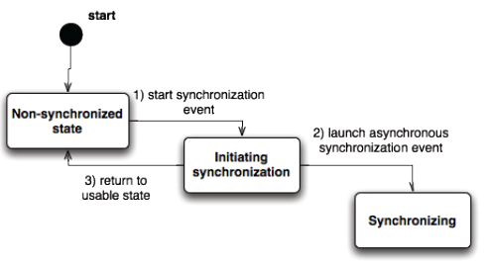
Visual Explanation
The Asynchronous Data Synchronization pattern is a mechanism pattern, thus it may be best visualized as a series of states.
When an application is “usable” (meaning the user can interact with the application) a synchronization event can be started.
Rather than executing the synchronization event sequentially, however, the event is launched asynchronously and the application returns to a usable state immediately.

Slide 6
Synchronous Data Synchronization
Problem
Some mobile application systems rely on datasets that must be accurate in real time or have certain time constraints limiting usability of the data.
Similarly, some mobile application systems may rely on the response for an action from a remote system before another action can be performed.
Solution
Initiate data transfer via a trigger (such as a user action, timer tick, etc.) and perform the transfer synchronously.
The application only proceeds to the next state when a result (positive or negative) is reached.

Slide 7
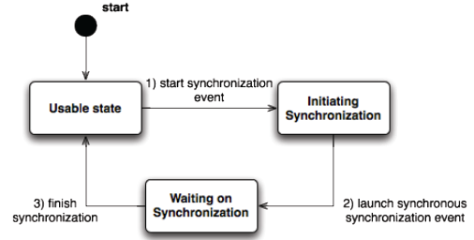
Visual Explanation
When an application is in a usable state, a synchronization event can be started.
The event is launched synchronously and executed in a sequential fashion, leaving the application in a waiting state until the synchronization is finished, whereupon it returns to the usable state.

Slide 8
Full Transfer
Problem
Some types of data (such as static files or datasets that change entirely after a synchronization event like a “Message of the Day”) either cannot use or will not benefit from a complex reconciliation scheme.
Moreover, some situations (such as a corrupt dataset) are more easily handled by a simple reconciliation scheme since a more complex scheme that uses fewer resources may take more time and effort to develop.
Solution
Reconcile data between a device and a remote system by transferring the entire contents of one to the other and making any appropriate changes when data is received.

Slide 9
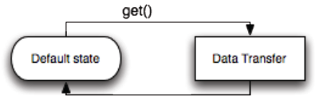
Visual Explanation
On a synchronization event, the entire dataset is transferred between the mobile device and the remote system.
The application simply initiates a transfer to obtain the entire dataset.

Slide 10
Timestamp Transfer
Problem
With the issue of network speed and bandwidth on mobile devices, the amount of data transferred to reconcile datasets between a device and a remote system should be minimized.
Solution
A timestamp provided by the remote system from the last successful update is bundled with a request for changed data.
The remote system returns only data that has been added or changed after that timestamp.
For submitting data, the device only submits data that has been added or changed since the last successful submission.

Slide 11
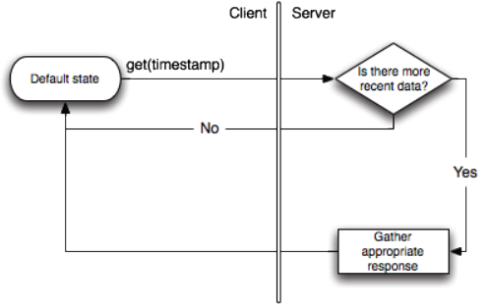
Visual Explanation
The client initiates a request and attaches a timestamp to the request, which is processed by the server to determine whether or not to return any data.

Slide 12
Mathematical Transfer
Problem
Network bandwidth and speed are concerns, so Full Transfer cannot be used to reconcile a dataset between a device and a remote system.
The structure of the dataset also may not be able to keep track of changes efficiently using Timestamp Transfer, or alternatively, a mathematical method can reconcile changes more easily or efficiently than timestamps can.
Solution
A mathematical method or algorithm decides what is transferred between a device and a remote system to synchronize a dataset.

Slide 13
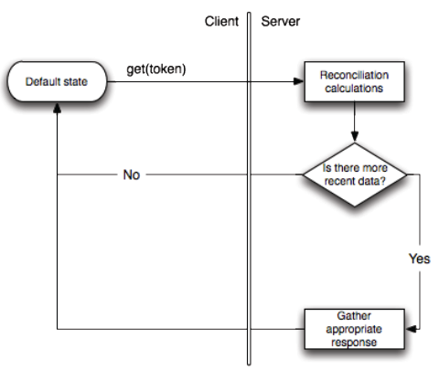
Visual Explanation
In Timestamp Transfer, this is simply a comparison, but in Mathematical Transfer, this could be a more significant calculation that should be considered a separate process.

Slide 14
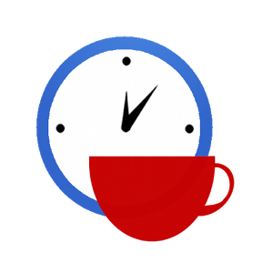

Slide 15
Cloud Component Gateway Pattern [2]
Motivation: How can an application component be made accessible in one cloud or datacenter, when it is hosted in a different cloud or datacenter and the communication between these environments is restricted?
The inbound communication from an off-premise environment to an on-premise environment is restricted: while the internal components residing in the on-premise environment may gain access to external components, no external access to internal components is allowed.

Slide 16
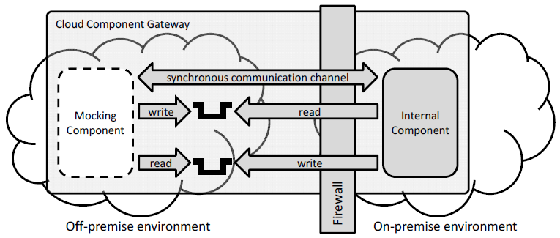
Cloud Component Gateway Pattern
This pattern is based on concepts of proxy and facade.
Duplicate the interface of the internal component in the off-premise environment.
This duplicate mocks the internal component’s interface and forwards accesses to the internal component.

Slide 18
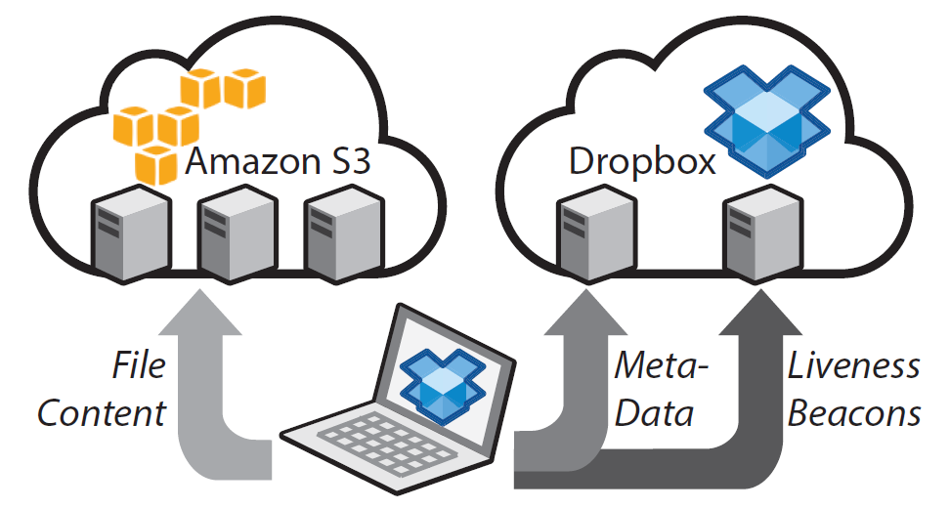
Client Control Flows [3]
The Dropbox client keeps continuously opened a TCP connection to a notification server (notifyX.dropbox.com), used for receiving information about changes performed elsewhere.
Authentication and file meta-data administration messages are exchanged with a separate set of servers, (client-lb.dropbox.com and/or clientX.dropbox.com).

Slide 19
Data Storage Flows
All store and retrieve operations are handled by virtual machines in Amazon EC2.
More than 500 distinct domain names (dl-clientX.dropbox.com) point to Amazon servers.
A subset of those aliases are sent to clients regularly.
Clients rotate in the received lists when executing storage operations, distributing the workload.

Slide 20
Web Interface
URLs containing dl-web.dropbox.com are used when downloading private content from user accounts.
The domain dl.dropbox.com provides public direct links to shared files.

Slide 21
Dropbox Data Sync Mechanism [4]
Periodically, the Dropbox client sends a message to the user’s beacon server to report its online status, as well as receives notifications from the cloud (e.g. a shared file has been modified by another user and should be re-synced).

Slide 22

Thank You & See You Again

